Slide 1



Slide 2
FHIR Deep Dive

Slide 3
Wiki: https://goo.gl/Izvh6s

Slide 4
Getting Started: HL7 Community

Slide 5
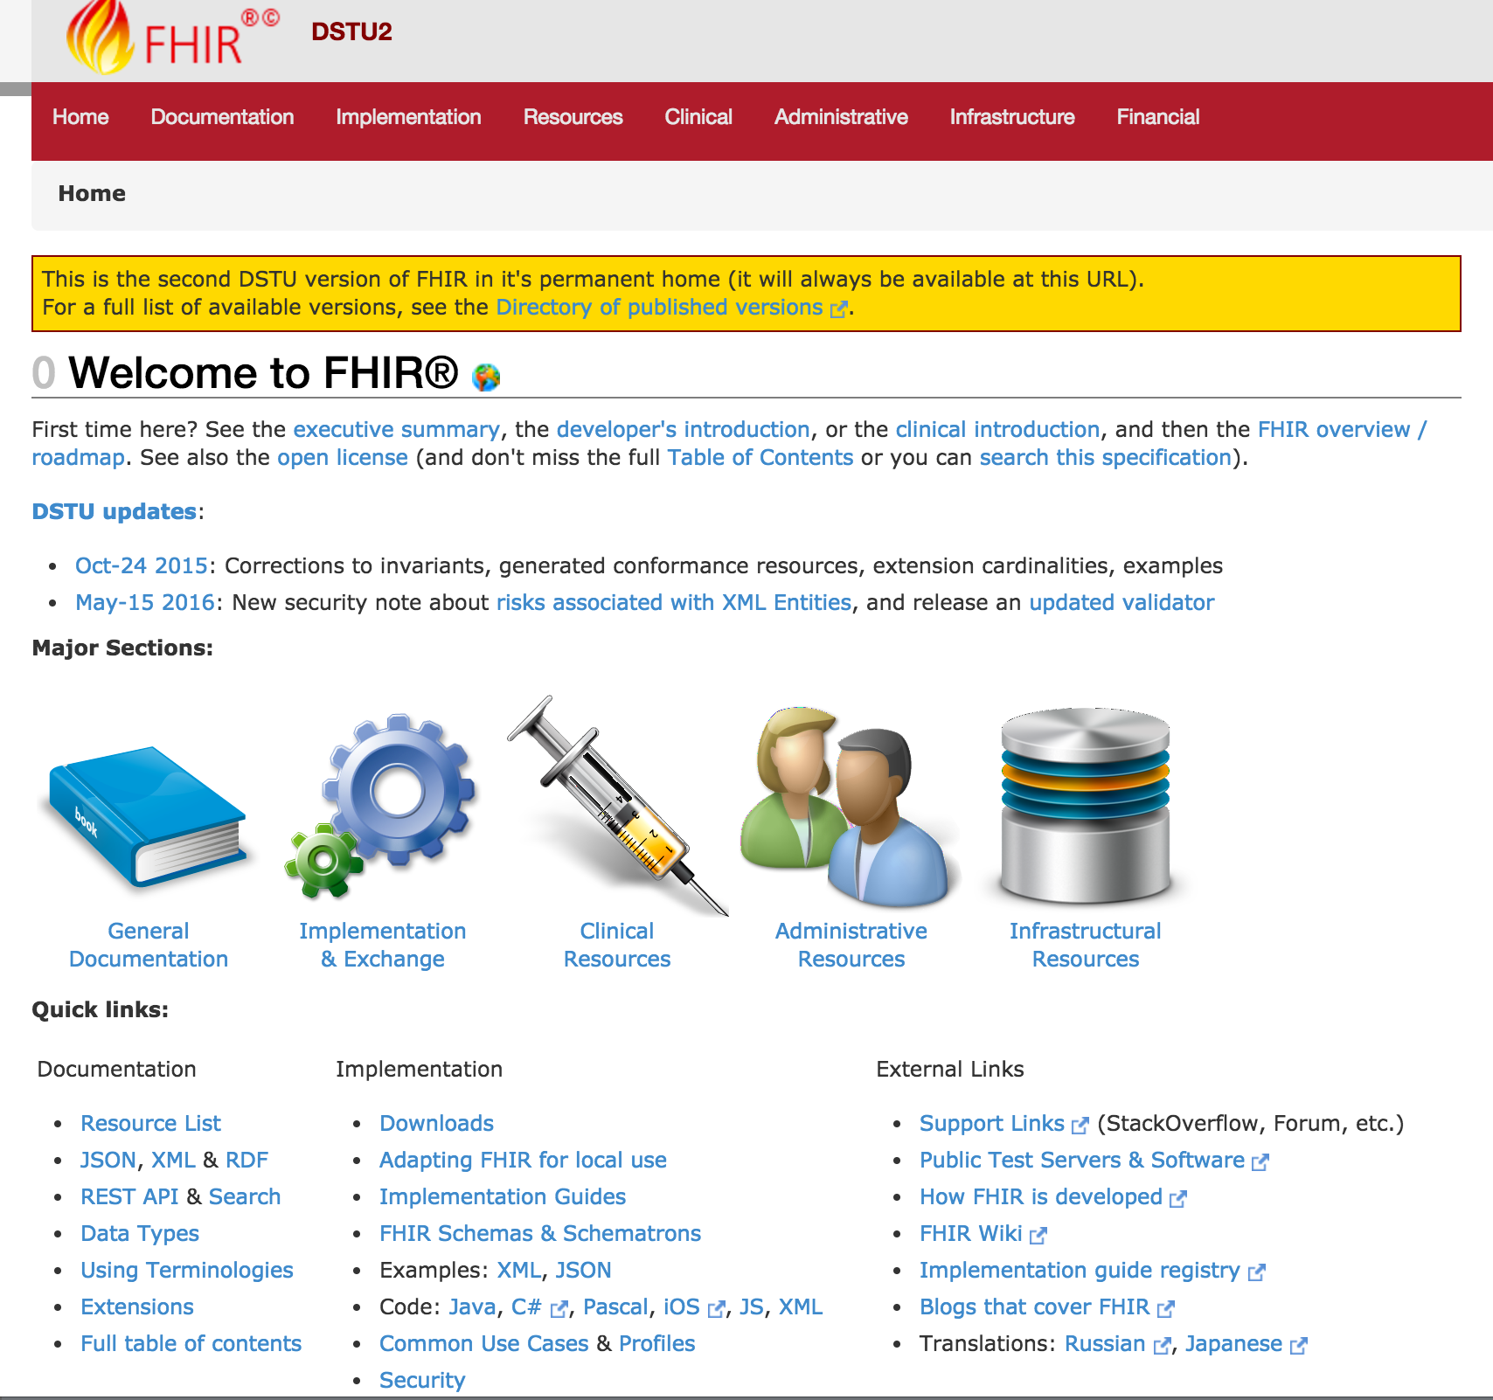




Versioning
Introductions
Support
Cheatsheets & Info
Updates
http://hl7.org/fhir/dstu2/index.html

Slide 6
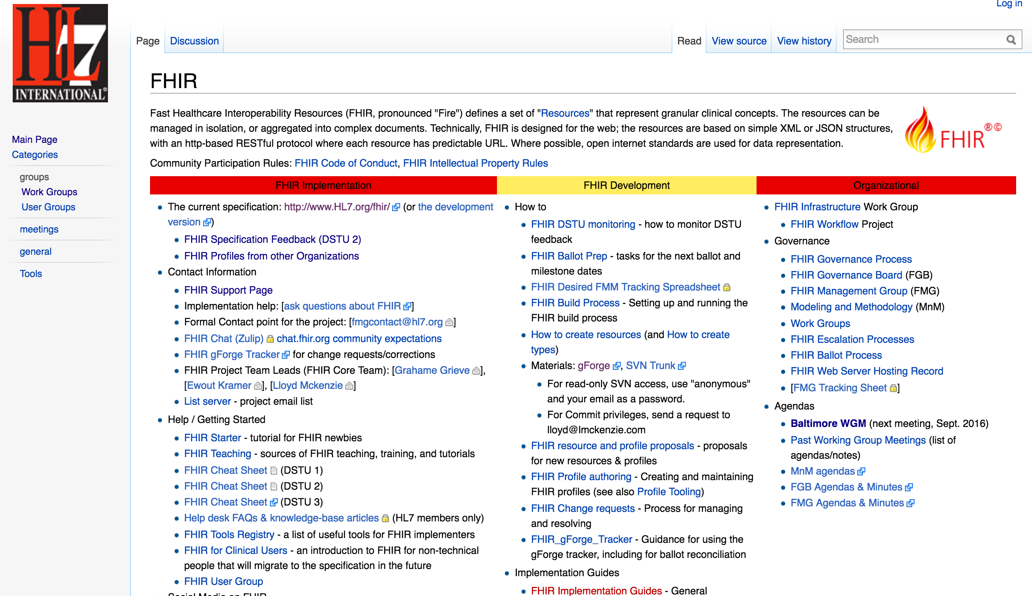
Getting Started
http://wiki.hl7.org/index.php?title=FHIR

Slide 7



Note: HAPI is the recommended Java Reference implementation
http://hapifhir.io/index.html
Resources
Spec Details
Reference Libraries

Slide 8
Specification Versioning

Slide 9
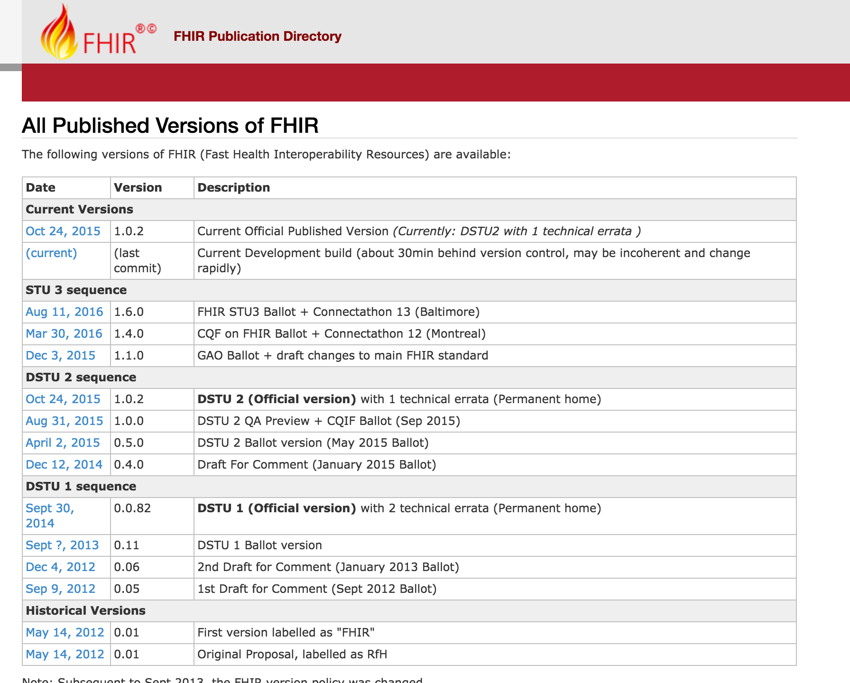
Current: DSTU2
AKA: 1.0.2
http://hl7.org/fhir/directory.html

Slide 10
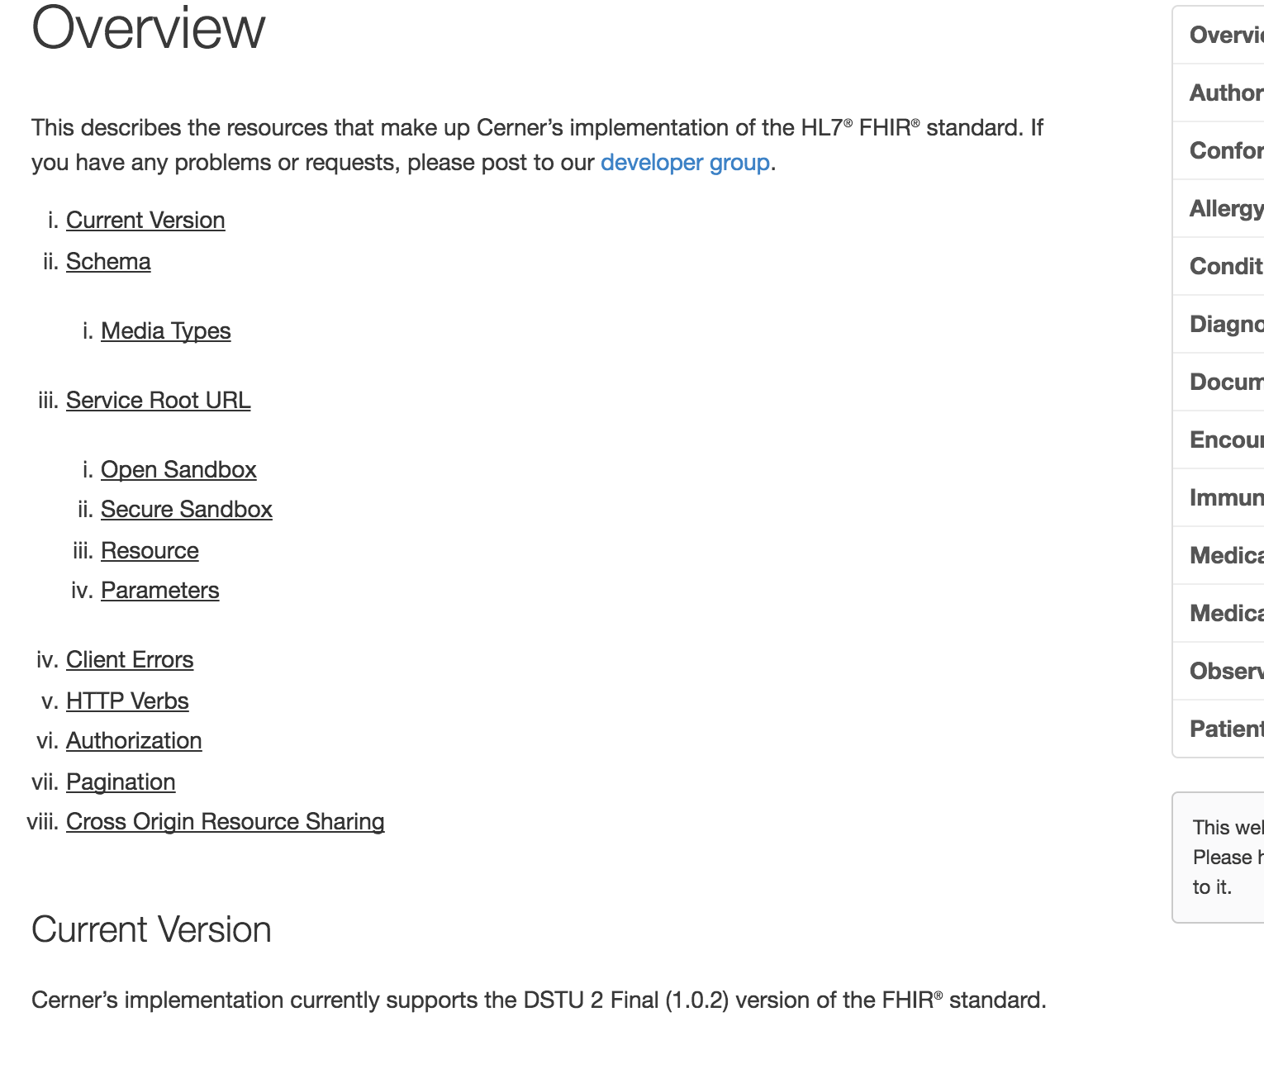
Latest Millennium Production: DSTU2/1.0.2
http://fhir.cerner.com/dstu2/

Slide 11

Which Version?
Multiple Available
Deprecate Oldest
Time to Uplift Applications

Slide 12
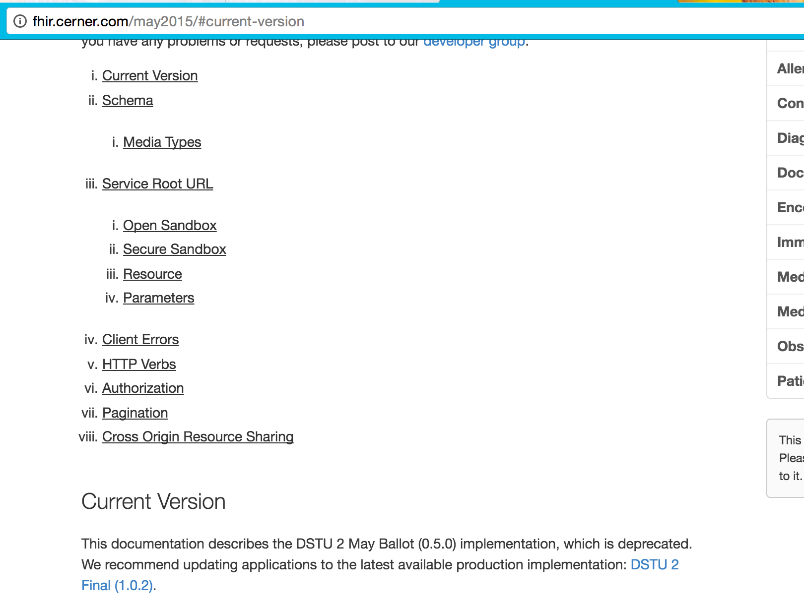
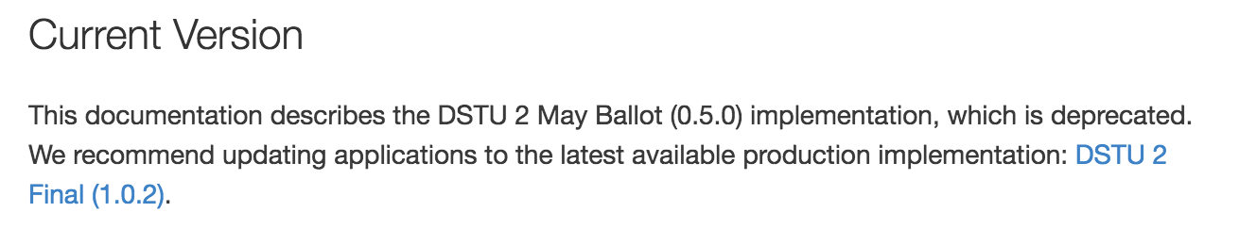
http://fhir.cerner.com/may2015/

Slide 13
Data Types

Slide 14
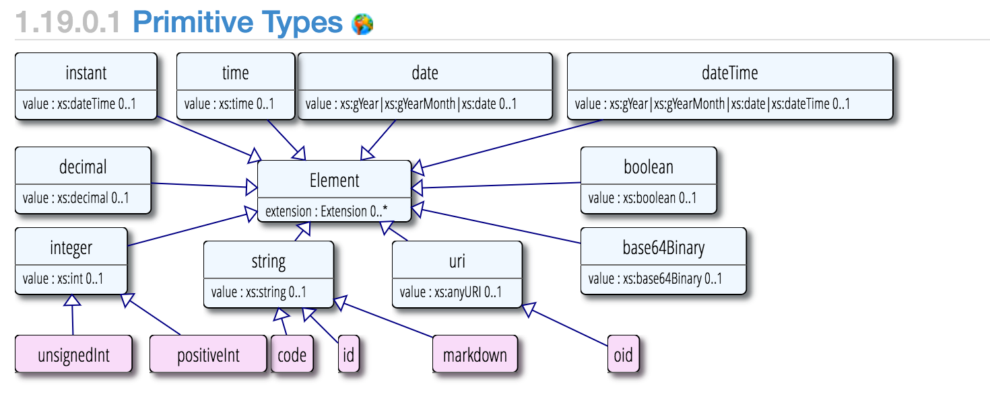
Primitive Types
http://hl7.org/fhir/dstu2/datatypes.html#primitive

Slide 15
Surprises
Decimal: 1.01, 1.010
Instant vs DateTime
DateTime vs Date vs Time
Notes:
Decimals, precision matters (e.g.: use big decimal)
Instant is for machines, DateTime is for humans. Instant MUST have seconds and zone.
DateTime is year, year/month, year/month/day, year/month/day/time (must have zone if there’s a time). Seconds are required (XML definition/schema), but can be ignored or zero.
Date is year, year/month, year/month/day
Time is zone-less, dateless (see you at 8:00 AM every day)

Slide 16
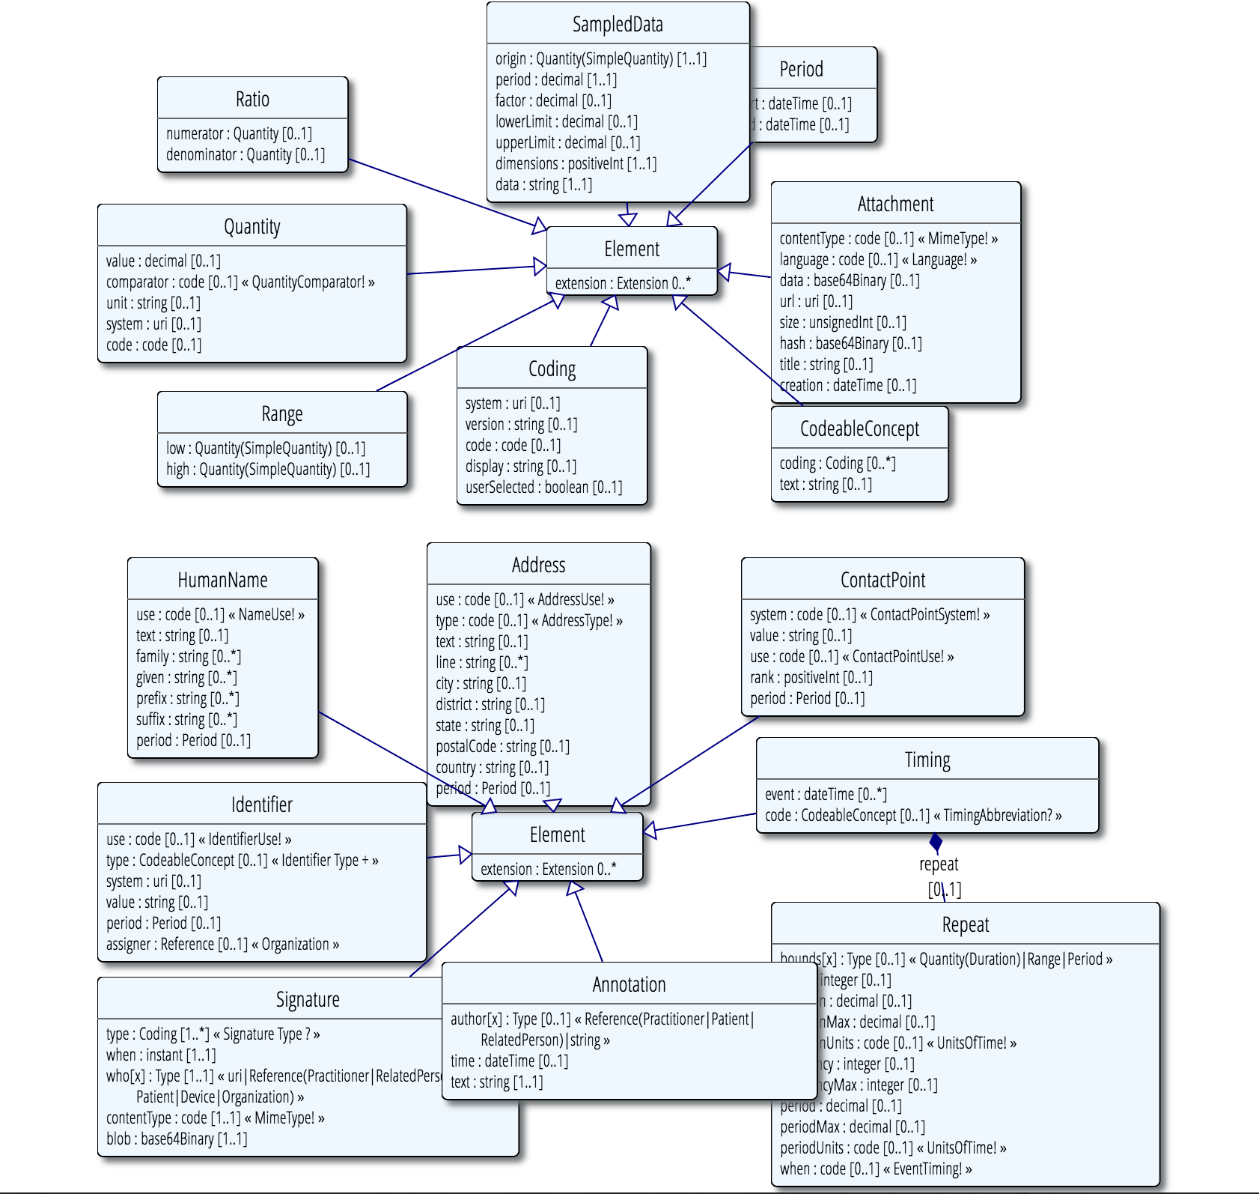
Complex Types
http://hl7.org/fhir/dstu2/datatypes.html#complex

Slide 17
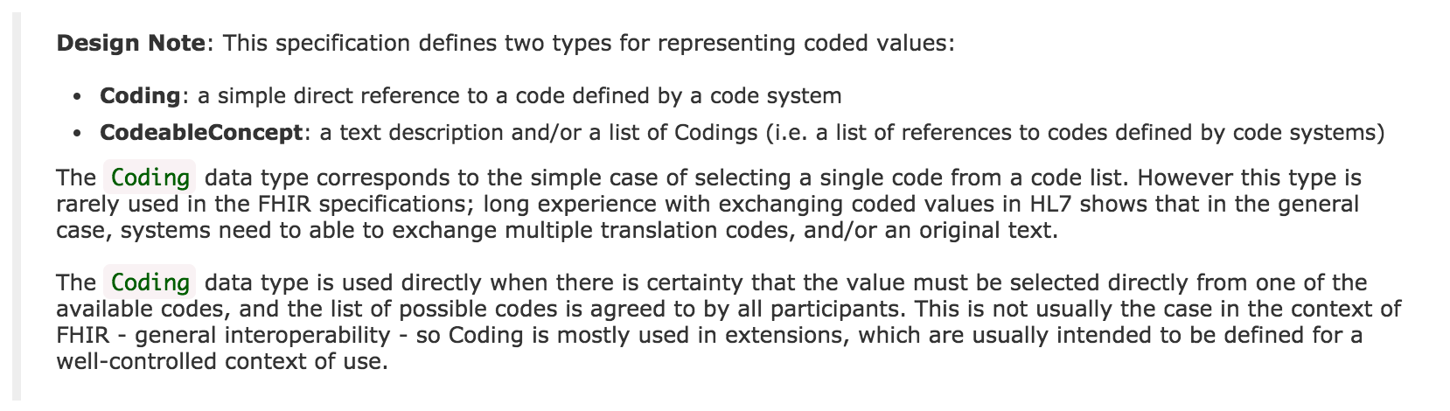
Code Systems
http://hl7.org/fhir/dstu2/datatypes.html#codesystem
Notes:
Code: codified value (usually from a set of values) to represent a concept.
Coding: Code + meta data (e.g., system, version)
CodeableConcept allows you to choose a list of codes, e.g.: multiple terminologies
CodeableConcept references Coding, Coding references a Code.
Code: m, f, unk
Coding: m, + system
CodeableConcept: Relationship type for patient contacts, Observation type (e.g.: height/weight, Loinc, SNOMED)

Slide 18
Formats
JSON and/or XML
Via Accept or Content-Type headers
Via _format parameter
http://hl7.org/fhir/dstu2/http.html#mime-type

Slide 19
Resources

Slide 20
Resources
Patient, Condition, MedicationOrder…
All resources have metadata
All resources have narrative
Structured data items
[base]/[Resource] (case sensitive)
[base]/Patient
http://hl7.org/fhir/dstu2/resource.html

Slide 21
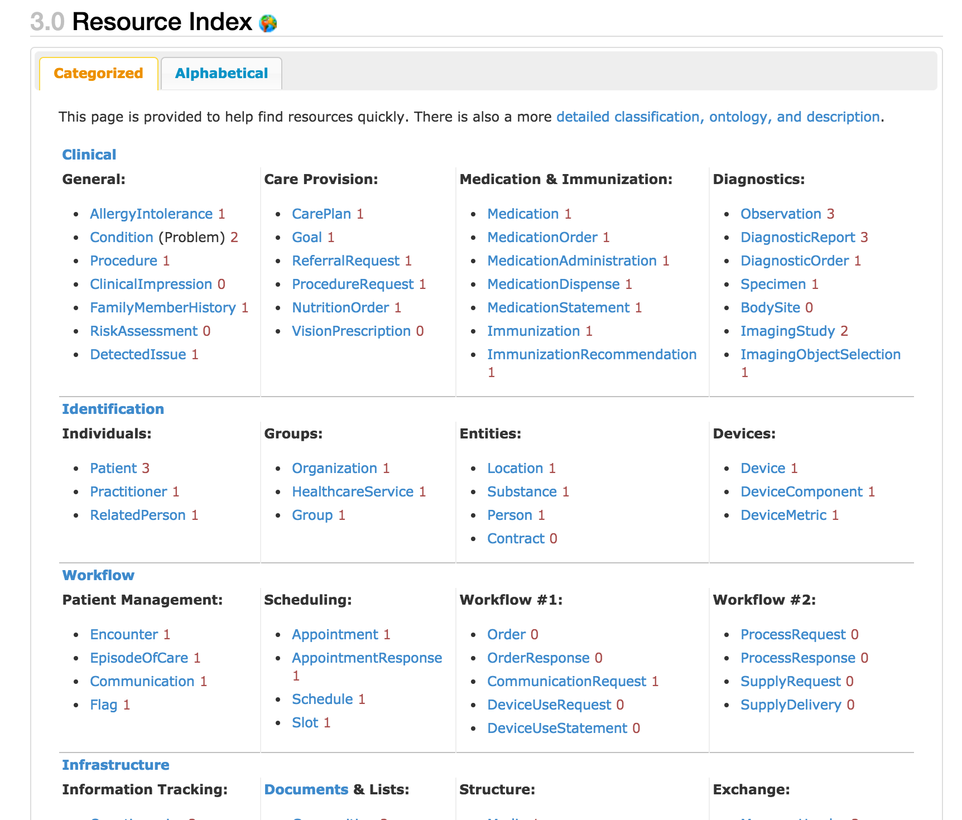
http://hl7.org/fhir/dstu2/resourcelist.html
Notes:
That number to the side…?

Slide 22
Maturity Levels
Risk for change
Lower number, highest risk
0-5
http://hl7.org/fhir/dstu2/resource.html#maturity
Notes:
If you are adverse to change, choose 4+
… which doesn’t exist in DSTU 2

Slide 23
Terminology Bindings

Slide 24
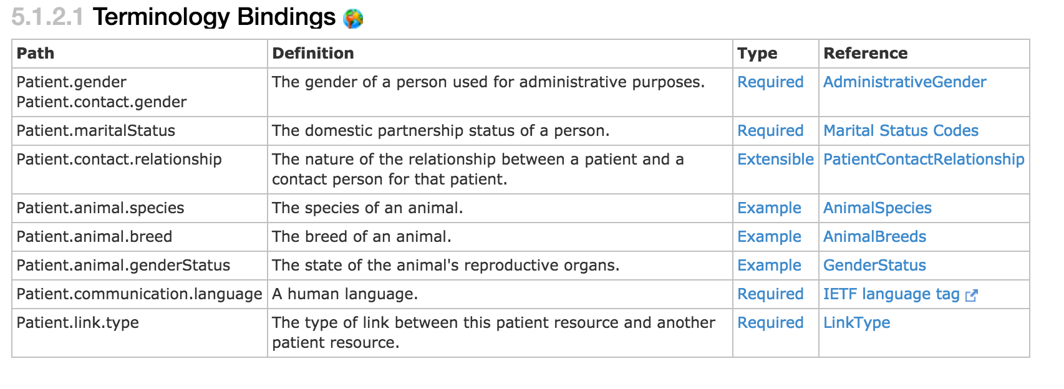
Terminology Bindings
http://hl7.org/fhir/dstu2/patient.html#tx

Slide 25
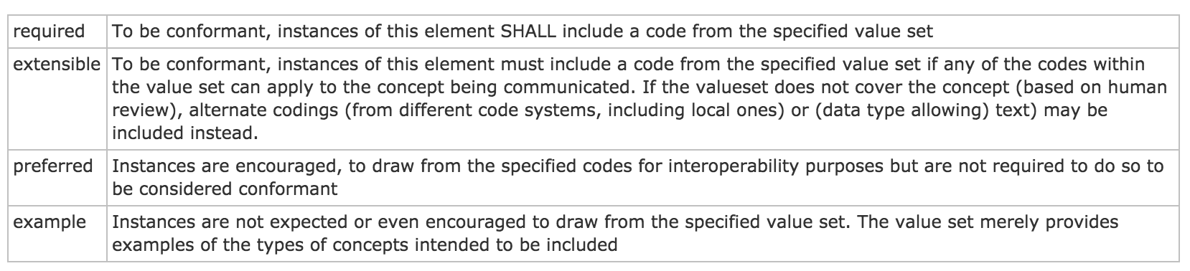
Type/Binding Strength
http://hl7.org/fhir/dstu2/terminologies.html#strength
Notes:
Required: for codeableConcept, you can’t just send “text”

Slide 26
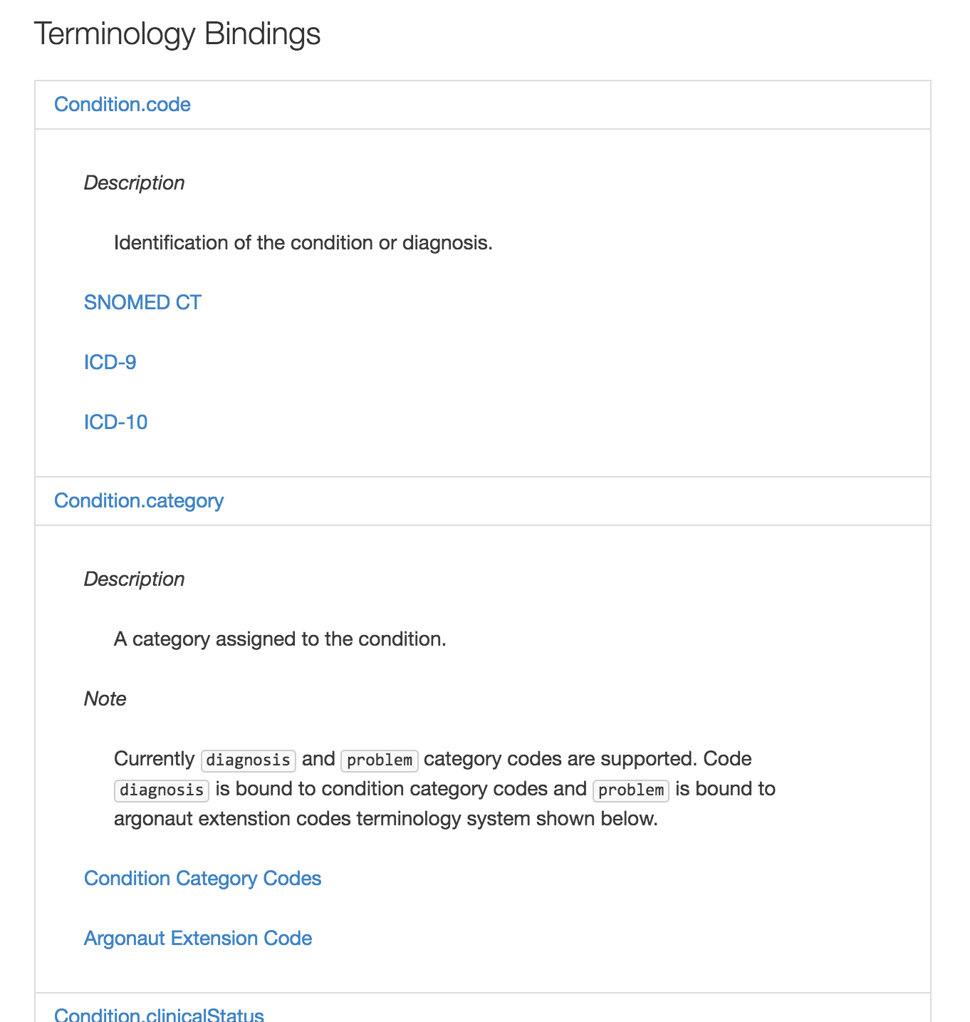
http://fhir.cerner.com/dstu2/condition/#terminology-bindings
Notes:
If a binding isn’t “required” by core spec, we’ll call out what our binding strength is in documentation

Slide 27
Narrative

Slide 28
“Any resource that is a domain resource (almost all types of resource) may include a human-readable narrative that contains a summary of the resource, and may be used to represent the content of the resource to a human. If narrative is present, it SHALL reflect all content needed for a human to understand the essential clinical and business information otherwise encoded within the resource. Resource definitions may define what content should be represented in the narrative to ensure clinical safety.”
http://hl7.org/fhir/dstu2/narrative.html#Narrative
Notes:
It is often the fall back if a client application doesn’t understand the FHIR resource in question

Slide 29
…”text”: {
"status": "generated",
"div": "<div><table><tbody><tr><td>Name</td><td>Peter James <b>Chalmers</b> (&quot;Jim&quot;)</td></tr><tr><td>Address</td><td>534 Erewhon, Pleasantville, Vic, 3999</td></tr><tr><td>Contacts</td><td>Home: unknown. Work: (03) 5555 6473</td></tr><tr><td>Id</td><td>MRN: 12345 (Acme Healthcare)</td></tr></tbody></table></div>"
}…

Slide 30
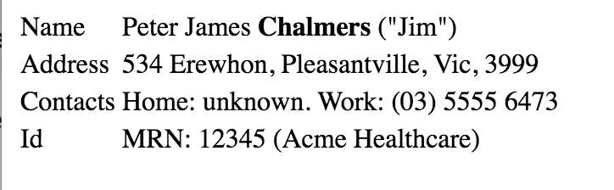

Slide 31
Exercise 1

Slide 32
Exercise 1
Identify the FMM (maturity model) of the Following resources for DSTU 2:
Patient
Condition
Observation
Coverage

Slide 33
Exercise 1: Answer
Identify the FMM (maturity model) of the Following resources for DSTU 2: http://hl7.org/fhir/dstu2/resourcelist.html
Patient: 3
Condition: 2
Observation: 3
Coverage: 0

Slide 34
Exercise 2

Slide 35
Exercise 2
Find out what resources are available in Millennium’s HL7 FHIR DSTU 2 implementation that are not in the May2015 implementation.

Slide 36
Exercise 2: Answer
Appointment
Binary
CarePlan
Contract
Device
Goal
OperationDefinition
Person
Procedure
RelatedPerson
Optional: MedicationOrder (MedicationPrescription was just renamed)

Slide 37
Exercise 3

Slide 38
Exercise 3
What search parameters does the Millennium DSTU 2 implementation of Patient support? Are there any limitations or considerations?

Slide 39
Exercise 3: Answer
Query by: id
Query by: identifier
Query by a combination of: birthdate, name, telecom
_count (paging)
birthdate, name, and telecom has limited availability, and “fuzzy”
http://fhir.cerner.com/dstu2/patient/#parameters

Slide 40
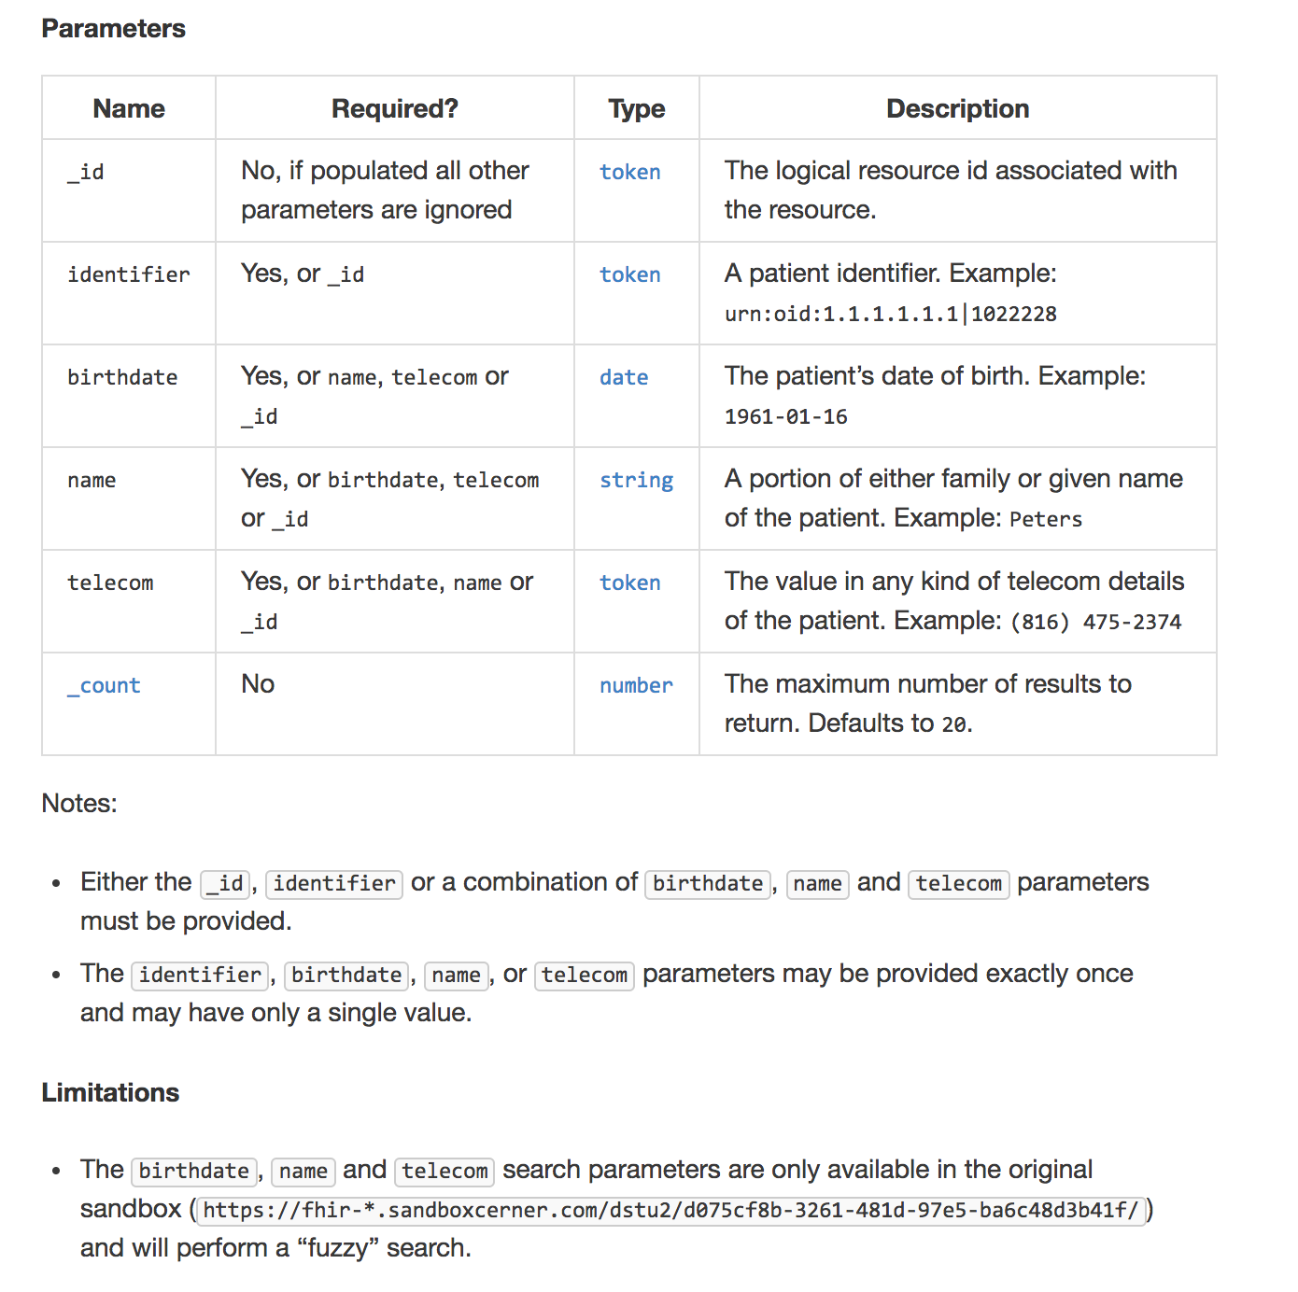

Slide 41
Read

Slide 42
Read
“By ID”
[base]/[Resource]/[id]
[base]/Patient/123ABC
http://hl7.org/fhir/dstu2/http.html#read

Slide 43
id vs identifier
id: logical identifier, must be unique within the FHIR server and resource
identifier: business identifier or “alias”
SSN
MRN
Military ID
http://hl7.org/fhir/dstu2/resource.html#id

Slide 44
Search

Slide 45
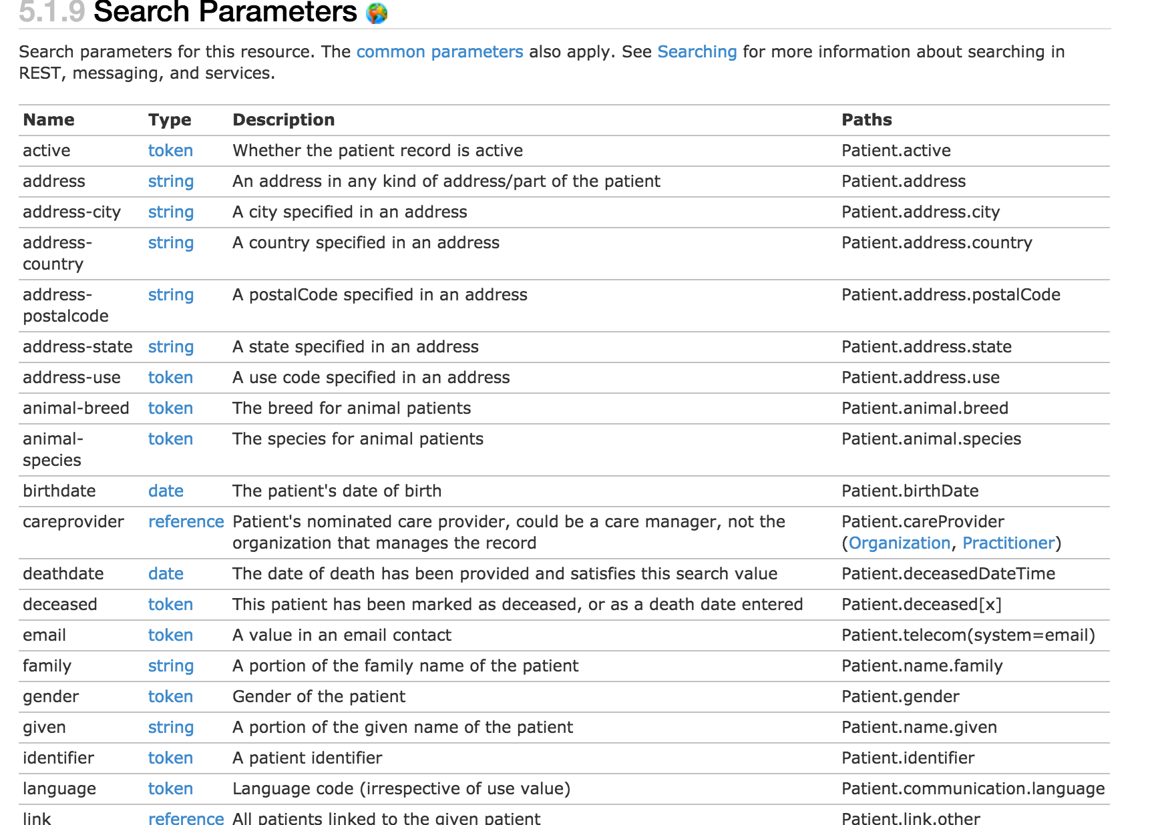
http://hl7.org/fhir/dstu2/patient.html#search

Slide 46
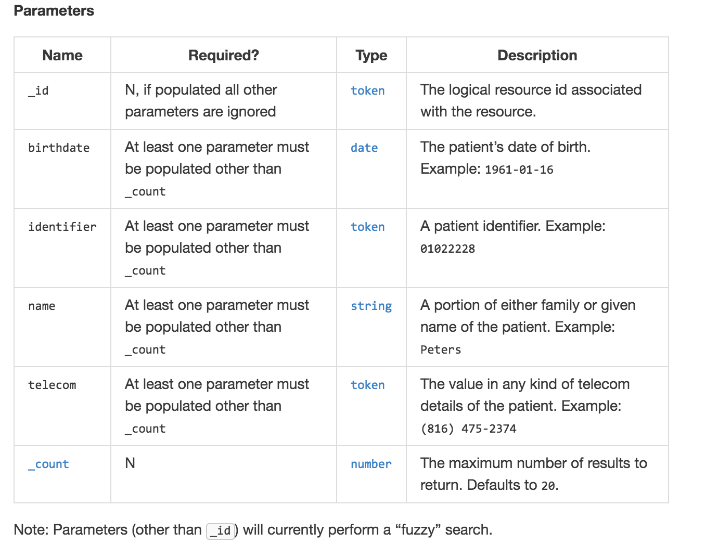
http://fhir.cerner.com/dstu2/patient/#parameters

Slide 47
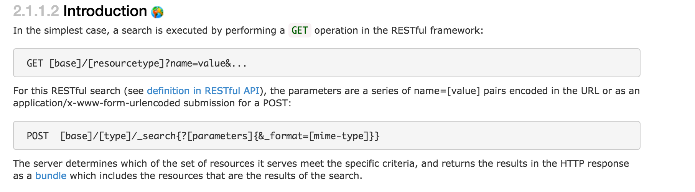
GET [base]/AllergyIntolerance?patient=123
http://hl7.org/fhir/dstu2/search.html
Notes:
This example is searching for all allergies for patient 123

Slide 48
Paging

Slide 49
Paging
Self, First, Previous, Next, Last
Must use link as provided
Changing this has undefined consequences
_count parameter
Less but not more
For interoperability - handle paging
http://hl7.org/fhir/dstu2/http.html#paging
Notes:
Handle paging in the application, which helps ensure you’re run against most servers. Check for the “next” link to see if there are additional pages.

Slide 50
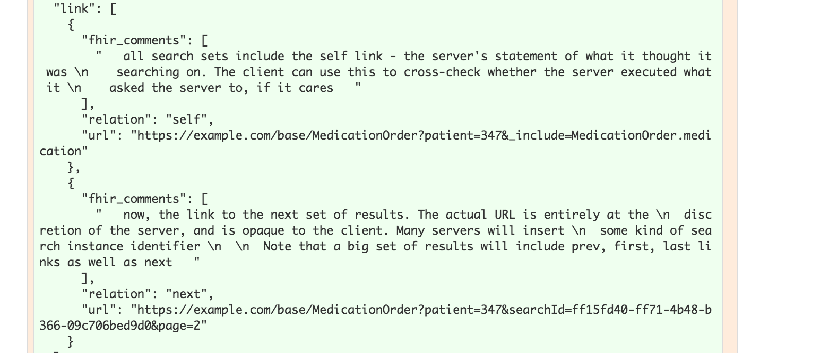
Notes:
The previous link isn’t in this example

Slide 51
Writes

Slide 52
Create
POST [base]/[Resource]
POST [base]/AllergyIntolerance
Body (content-type) must match supported FHIR format
http://hl7.org/fhir/dstu2/http.html#create

Slide 53
Update
PUT [base]/[Resource]/[id]
PUT [base]/AllergyIntolerance/123
Body (content-type) must match supported FHIR format
http://hl7.org/fhir/dstu2/http.html#update

Slide 54
Conditional Update
Optimistic Locking via “If-Match”
Example: Version in database: 2a
Version in “If-Match”: 1a - failure
Version in “If-Match”: 2a - success
http://hl7.org/fhir/dstu2/http.html#2.1.0.10.2

Slide 55
Exercise 4

Slide 56
Exercise 4
Find out the middle name for Patient Fred Smart

Slide 57
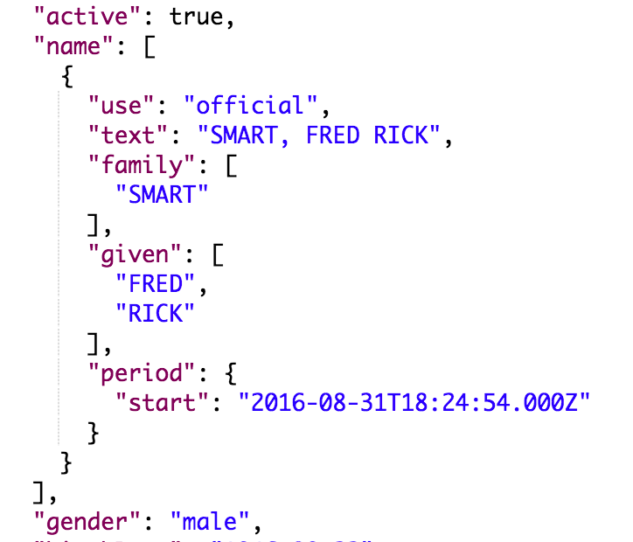
Exercise 4: Answer
Answer: Rick
GET https://fhir-open.sandboxcerner.com/dstu2/0b8a0111-e8e6-4c26-a91c-5069cbc6b1ca/Patient/4478007?_format=json
http://hl7.org/fhir/dstu2/datatypes.html#HumanName (middle is subsequent given name)
Notes:
Note: Patient vs Person. Person represents people “in the real world” for example, it could link to your patient record in many FHIR servers. In CommonWell, most of the core is the “Person” and the records they’re tied to are Patient. We would use Patient here since we’re looking at patient records in an EHR.

Slide 58
Exercise 5

Slide 59
Exercise 5
How many current allergies or intolerances does Tim Peters have?
Current: actual or possible existing allergies or intolerances
Hint: What indicates “current” for this FHIR resource?

Slide 60
Exercise 5: Answer
21
GET https://fhir-open.sandboxcerner.com/dstu2/0b8a0111-e8e6-4c26-a91c-5069cbc6b1ca/AllergyIntolerance?patient=1316024&_format=json
GET https://fhir-open.sandboxcerner.com/dstu2/0b8a0111-e8e6-4c26-a91c-5069cbc6b1ca/AllergyIntolerance?patient=1316024&status=active,unconfirmed,confirmed&_format=json
Notes:
Note: AllergyIntolerance/123 is looking up an Allergy by its id (not a patient id). Similarly, AllergyIntolerance?_id=123 is looking up allergy by id, not by the patient id.

Slide 61
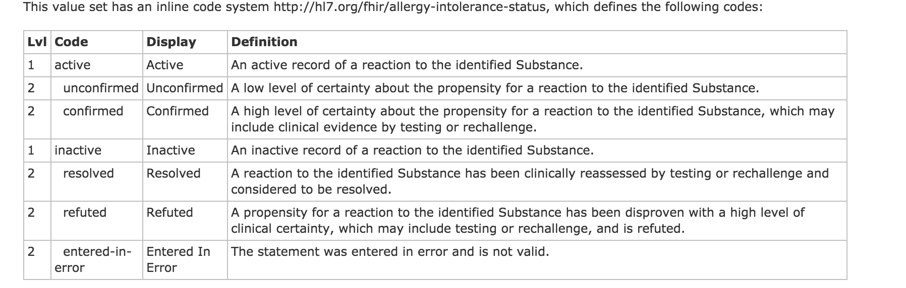
http://hl7.org/fhir/DSTU2/valueset-allergy-intolerance-status.html

Slide 62

What if it wasn’t mapped/known?
http://hl7.org/fhir/dstu2/allergyintolerance.html
Notes:
Be aware that querying by a field that isn’t required may mean that values that weren’t mapped or understood by the FHIR server won’t be returned.
In the Allergy case, STU 3 is addressing this issue with allergies by requiring the status and adding an “unknown” that could be used to ensure all possible allergies can be retrieved.

Slide 63
Exercise 6

Slide 64
Exercise 6
How many different MedicationOrders of Advil Cold and Sinus does Tim Peters have?

Slide 65
Exercise 6: Answer
1
GET https://fhir-open.sandboxcerner.com/dstu2/0b8a0111-e8e6-4c26-a91c-5069cbc6b1ca/MedicationOrder?patient=1316024&status=active,on-hold&_format=json

Slide 66
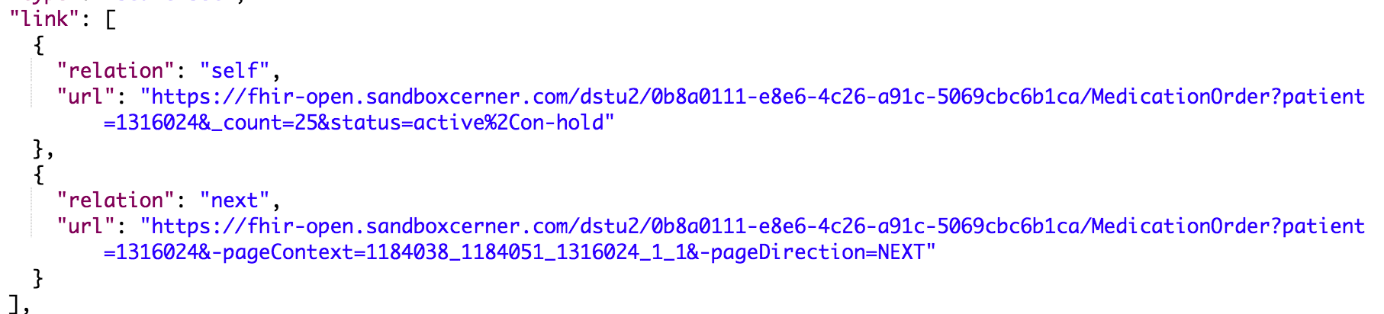
Paging
GET https://fhir-open.sandboxcerner.com/dstu2/0b8a0111-e8e6-4c26-a91c-5069cbc6b1ca/MedicationOrder?patient=1316024&-pageContext=1184038_1184051_1316024_1_1&-pageDirection=NEXT&_format=json
Added _format parameter

Slide 67
MedicationStatement?
Could have, though question said order.
Result would have been the same, but statuses would have been “active,intended”

Slide 68
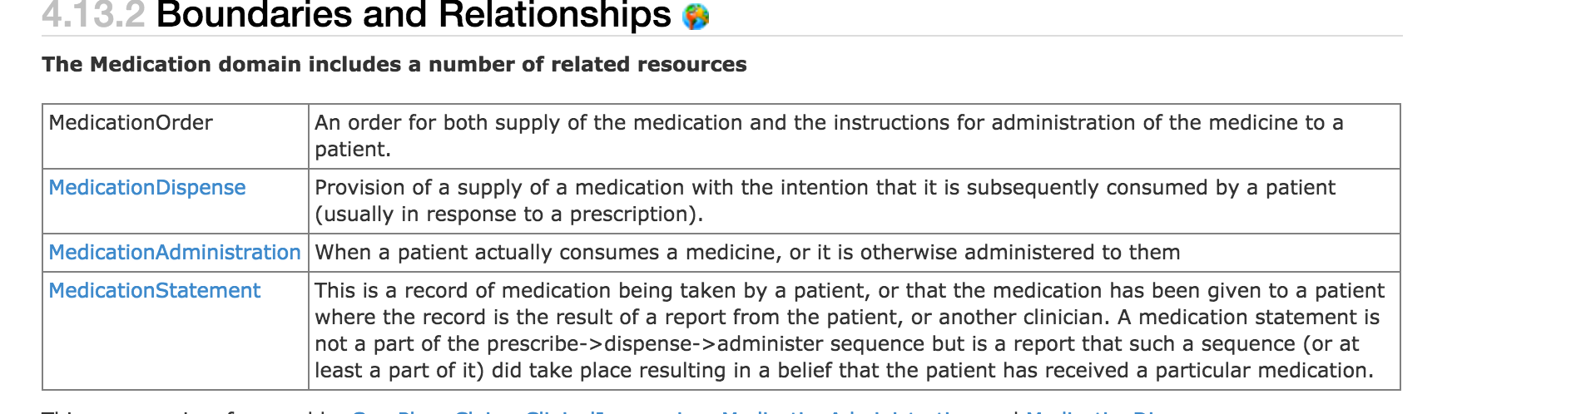
http://hl7.org/fhir/dstu2/medicationorder.html#bnr

Slide 69
Exercise 7

Slide 70
Exercise 7
What is the name of the patient with MRN 10000363
Hint: the system is urn:oid:1.1.1.1.1.1 (oid)

Slide 71
Exercise 7: Answer
Amy Hilton
GET https://fhir-open.sandboxcerner.com/dstu2/0b8a0111-e8e6-4c26-a91c-5069cbc6b1ca/Patient?identifier=urn:oid:1.1.1.1.1.1|10000363&_format=json

Slide 72
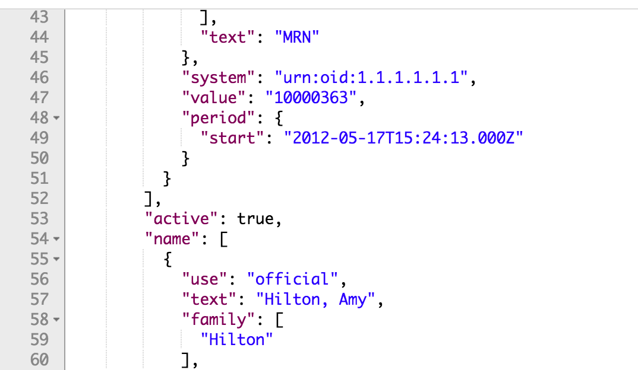

Slide 73
Extensions

Slide 74
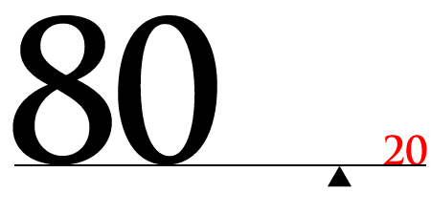
http://hl7.org/fhir/dstu2/extensibility.html

Slide 75
Extension “Rules”
They’re Expected
They can nest
Server/Client cannot reject because of extension
Unless it’s a modifier

Slide 76
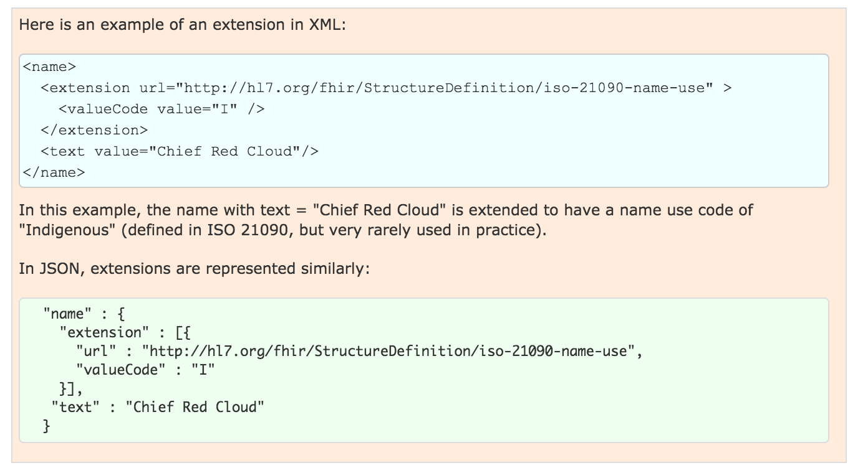
Examples

Slide 77
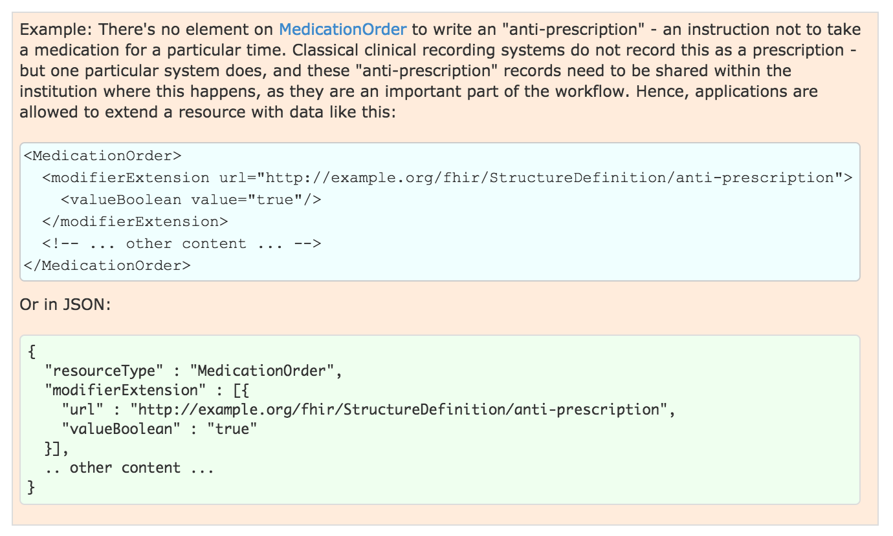
Modifier Example
Notes:
Note: this should show in the narrative

Slide 78
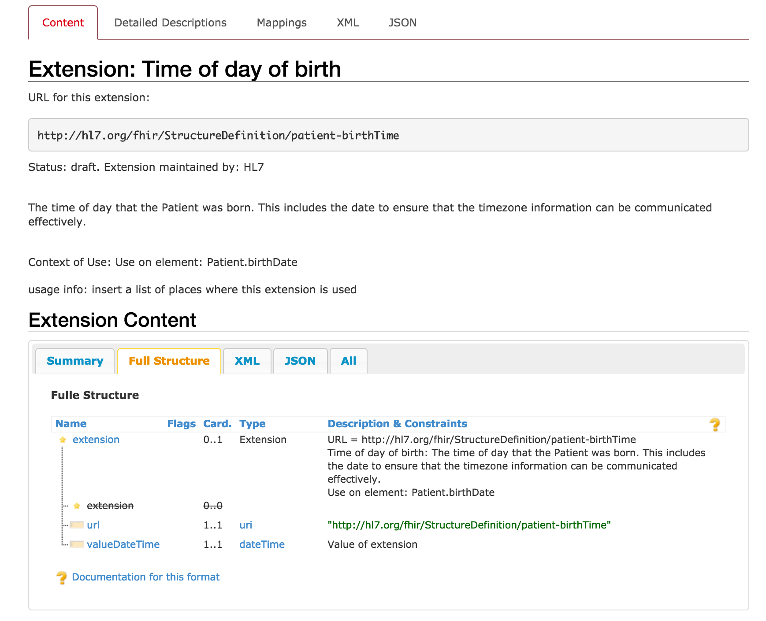
http://hl7.org/fhir/dstu2/extension-patient-birthtime.html
Notes:
Not a modifier
Extension to patient.birthDate

Slide 79
Conformance

Slide 80
Conformance Resource
Weird: located at [base]/Conformance [base]/metadata
Describes the Server
Step towards auto-config
http://hl7.org/fhir/dstu2/conformance.html
Notes:
Can be used to describe other things, like desired implementations or capabilities, we’ll concentrate on describing a FHIR server contract.
Not enough to completely configure, but a step in that direction

Slide 81

What?
Which operations?
Which parameters?
Which formats?
Profiles…
Notes:
It defines a large part of the contract

Slide 82
Exercise 8

Slide 83
Exercise 8
Which extensions are supported by the Millennium DSTU 2 Patient resource?

Slide 84
Exercise 8: Answer
Time of day of birth
US Core Ethnicity
US Core Patient Birth Sex
US Core Race
http://fhir.cerner.com/dstu2/patient/#extensions

Slide 85
Exercise 9

Slide 86
Exercise 9
According to the Conformance statement, does this FHIR server support OAuth? https://fhir-open.sandboxcerner.com/dstu2/0b8a0111-e8e6-4c26-a91c-5069cbc6b1ca/
Notes:
Note: Make sure to remove spaces in your URL for FHIR - there should be none, and having spaces in the server URL will cause errors. HTTP URLs are space and case sensitive.

Slide 87
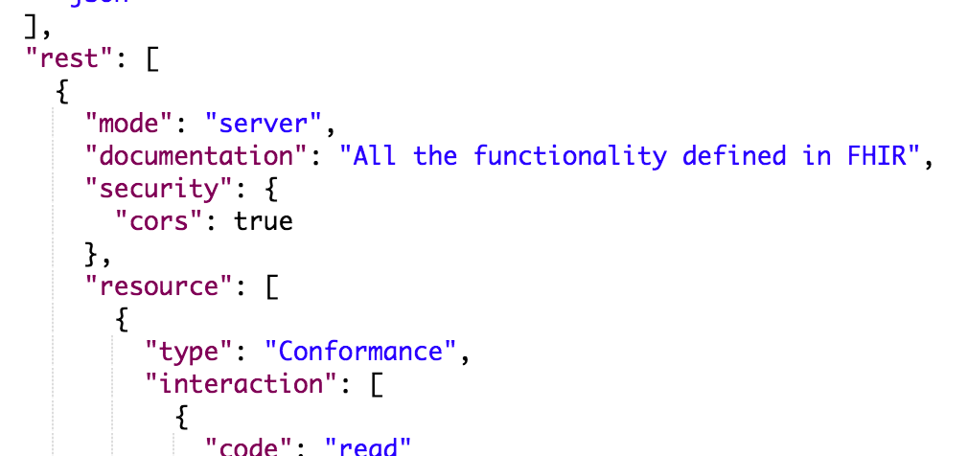

Exercise 9: Answer
Answer: No (it’s our open endpoint)
GET https://fhir-open.sandboxcerner.com/dstu2/0b8a0111-e8e6-4c26-a91c-5069cbc6b1ca/metadata?_format=json

Slide 88
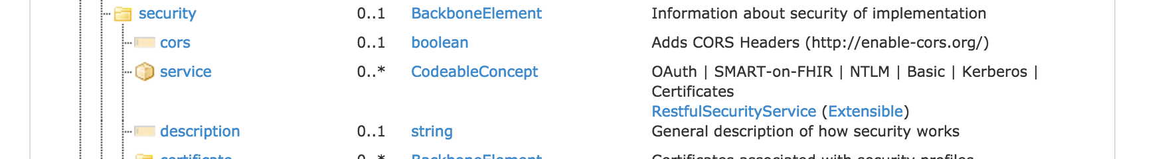

http://hl7.org/fhir/dstu2/conformance.html

Slide 89
Profiles

Slide 90
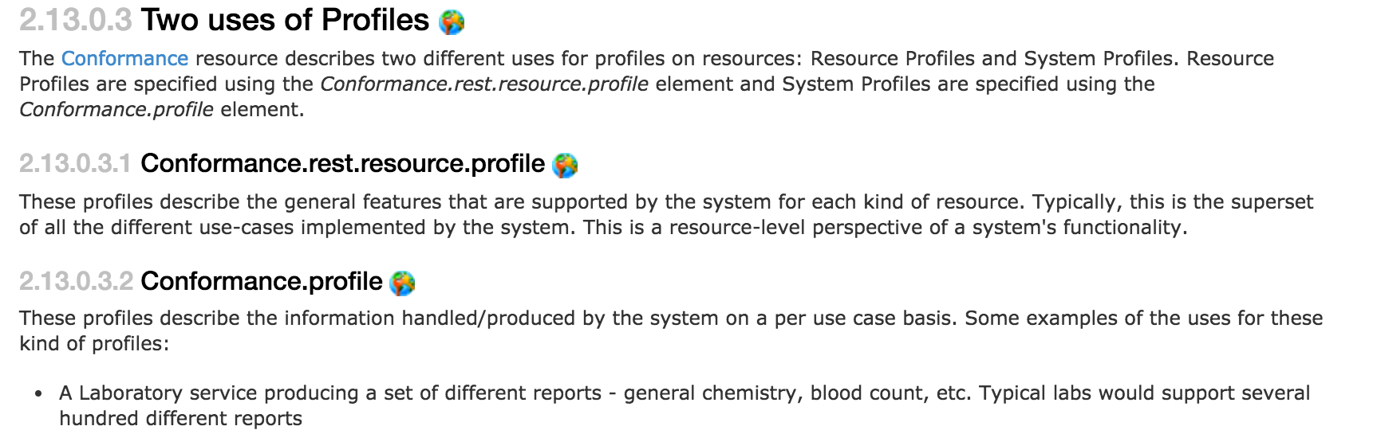
What
http://hl7.org/fhir/dstu2/profiling.html
Notes:
StructureDefinition resource (in DSTU 2)
Detailed description of contracts, per user case or per system

Slide 91
Rules
Detailed contract
Parameters, operations, api calls
Fields, cardinality
Terminology binding, extensions
Must be compatible with core
Can’t change required binding
Cardinality can restrict more (1..* to 1..1 but not 0..*)
Can’t rename fields
Notes:
Compatible: If core binds as required, you can’t change it
If core has 1..*, you can’t change to 0..*, but can change to 1..1
Goal: must be safe to process a resource without the profile

Slide 92
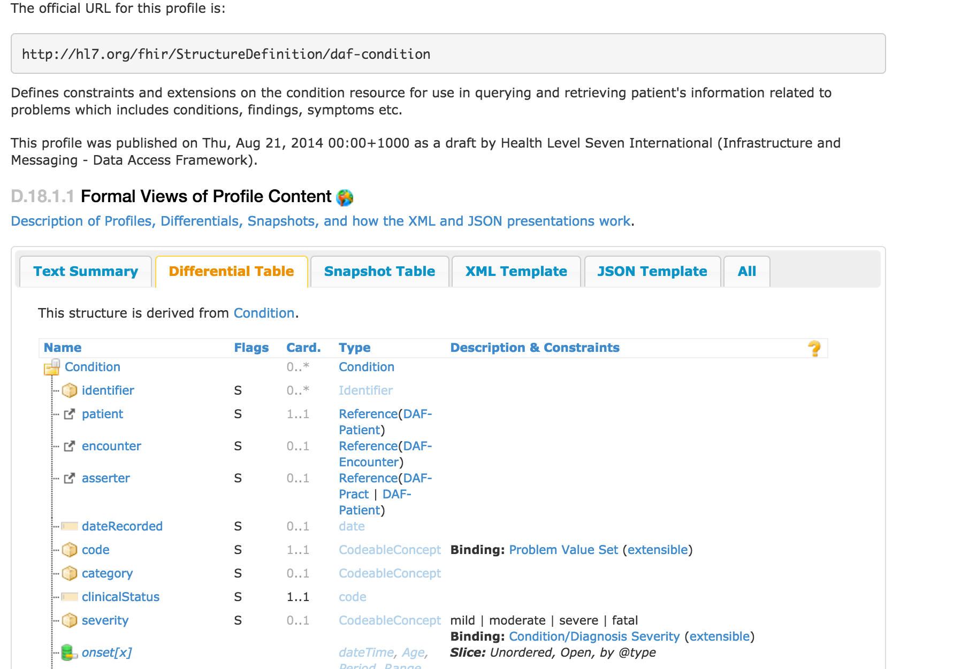
DAF Condition
http://hl7.org/fhir/dstu2/daf/daf-condition.html
Notes:
Part of an Implementation Guide (DAF)
Differential is good at showing differences from core
“Must Support” - it’s fuzzy…
This profile binds Condition.code to a value set, binds severity

Slide 93
Argonaut IG
http://www.fhir.org/guides/argonaut/r2/
Standard Profiles for defined use cases
Address issues from the JASON Task Force reports
http://hl7.org/fhir/dstu2/iglist.html

Slide 94
Questions?

Slide 95
More Exercises!

Slide 96
Exercise 10

Slide 97
Exercise 10
Does Wilma Smart have a normal blood pressure?
Hint: LOINC 55284-4 can be used to find blood pressures

Slide 98
Exercise 10: Answer
No - it’s High
GET https://fhir-open.sandboxcerner.com/dstu2/0b8a0111-e8e6-4c26-a91c-5069cbc6b1ca/Observation?subject%3APatient=4342008&code=http%3A%2F%2Floinc.org%7C55284-4&_format=json (code: http://loinc.org|55284-4)
Notes:
You need to ensure you properly escape/encode the URL so that protected characters are percent encoded. This is to ensure that the server can interpret the URL correctly. Postman does this for you, and *some* http libraries will, but make sure your code (or app) handles this logic to encode or decode as needed.

Slide 99
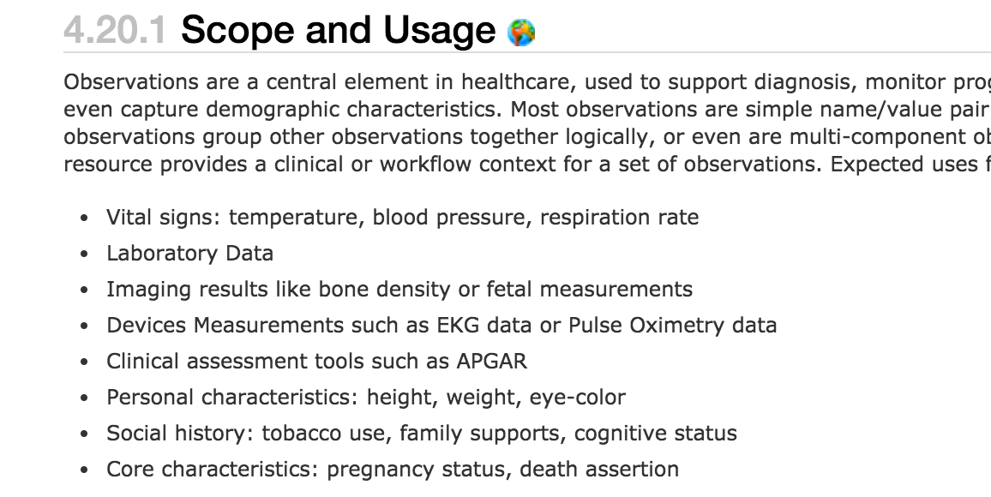
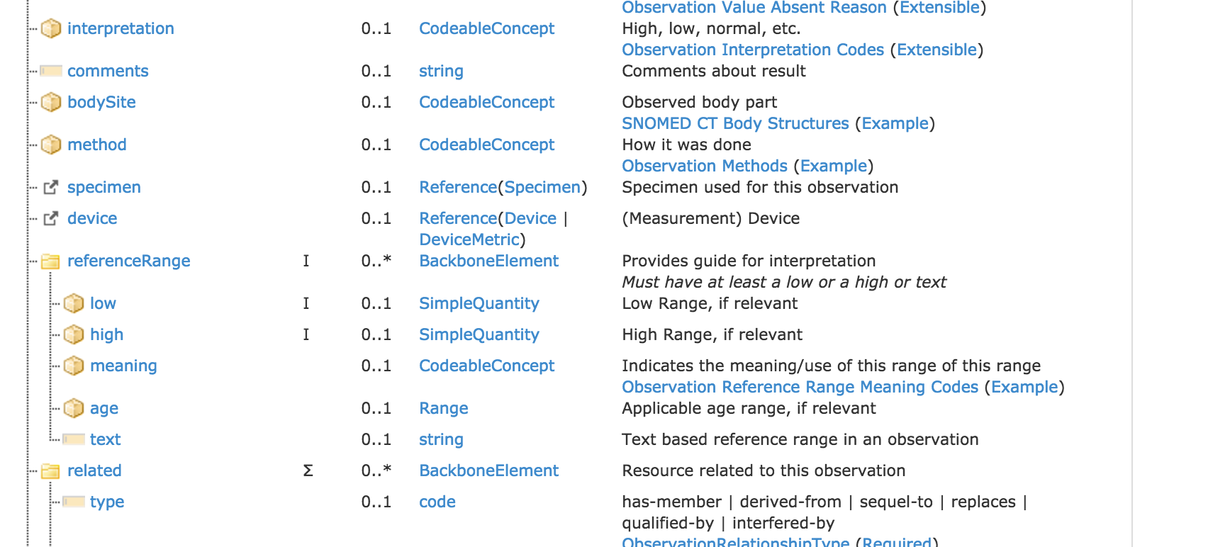
http://hl7.org/fhir/dstu2/observation.html

Slide 100
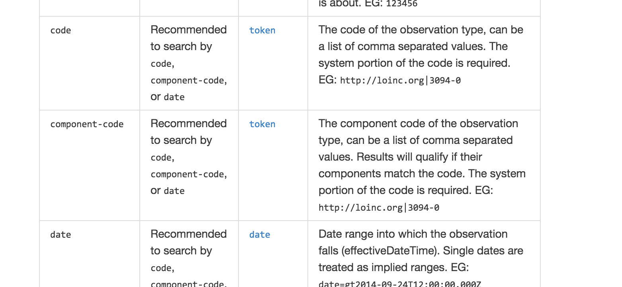
http://fhir.cerner.com/dstu2/observation/

Slide 101
Exercise 11

Slide 102
Exercise 11
Is Fred Smart currently taking insulin?

Slide 103
Exercise 11: Answer
Answer: Yes
GET https://fhir-open.sandboxcerner.com/dstu2/0b8a0111-e8e6-4c26-a91c-5069cbc6b1ca/MedicationStatement?patient=4478007&_format=json
GET https://fhir-open.sandboxcerner.com/dstu2/0b8a0111-e8e6-4c26-a91c-5069cbc6b1ca/MedicationOrder?patient=4478007&_format=json

Slide 104
Exercise 12

Slide 105
Exercise 12
Which has a pacemaker: Fred Smart or Tim Peters?

Slide 106
Exercise 12: Answer
Fred
GET https://fhir-open.sandboxcerner.com/dstu2/0b8a0111-e8e6-4c26-a91c-5069cbc6b1ca/Device?patient=4478007&_format=json
and possibly Google (Medtronic Advisa MRI SureScan)
GET https://fhir-open.sandboxcerner.com/dstu2/0b8a0111-e8e6-4c26-a91c-5069cbc6b1ca/Device?patient=1316024&_format=json

Slide 107
Exercise 13

Slide 108
Exercise 13
Who is patient Tim Peter’s son?

Slide 109
Exercise 13: Answer
Answer: Cooper, Timothy
GET https://fhir-open.sandboxcerner.com/dstu2/0b8a0111-e8e6-4c26-a91c-5069cbc6b1ca/RelatedPerson?patient=1316024&_format=json

Slide 110
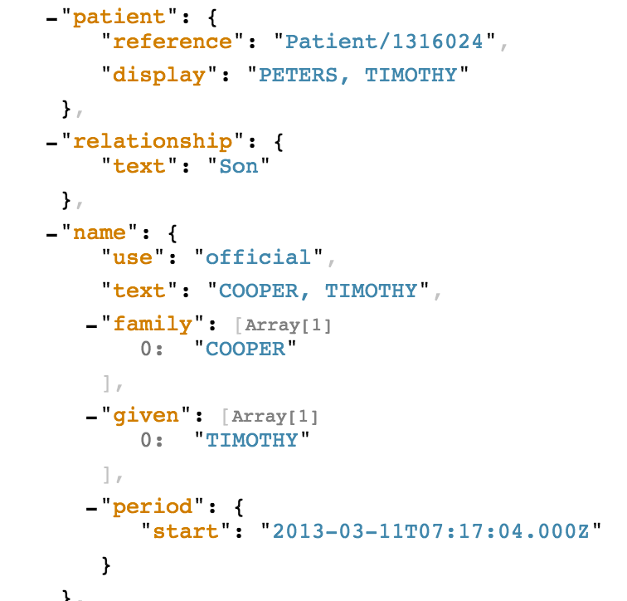

Slide 111
Exercise 14

Slide 112
Exercise 14
What happens when you query MedicationStatement for Joe Smart and filter by a status of draft? Why?

Slide 113
Exercise 14: Answer
Answer: An error (400), because draft isn’t in the value set
GET https://fhir-open.sandboxcerner.com/dstu2/0b8a0111-e8e6-4c26-a91c-5069cbc6b1ca/MedicationStatement?patient=4342010&status=draft&_format=json
http://fhir.cerner.com/dstu2/condition/#terminology-bindings

Slide 114
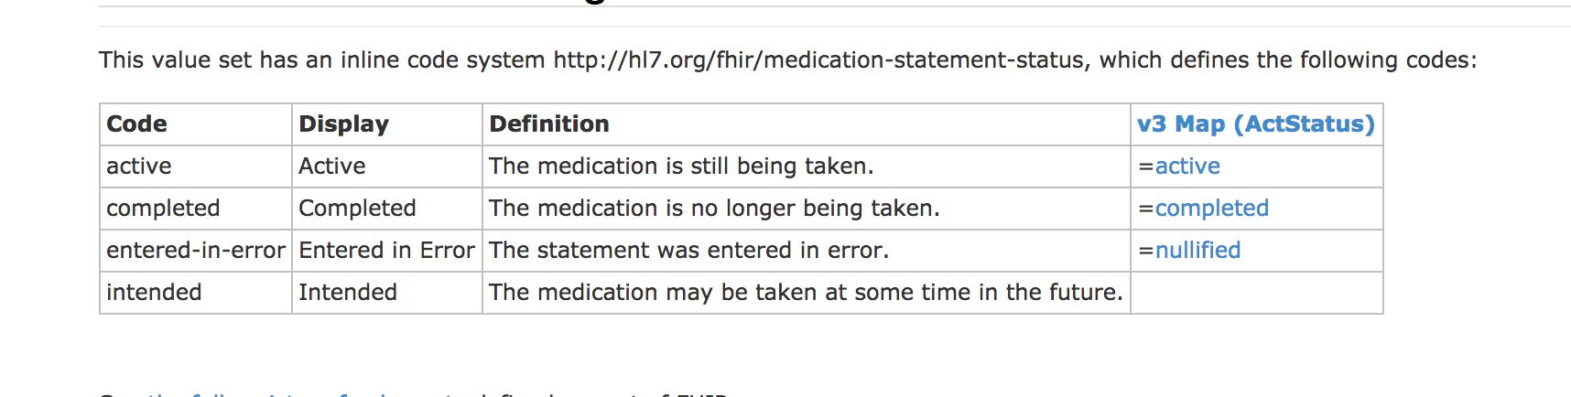
http://hl7.org/fhir/DSTU2/valueset-medication-statement-status.html

Slide 115
